Slide 1
Building access
By Elexa Evans

Slide 2
Brief description
The client is looking to install an access card system building- wide that only allows employees to certain floors and areas. This building has 8 floors, housing 7 companies and the 7th and 8th floor is the same company. Each company’s employees will have access to their company’s floor with the 6th floor having two additional areas that requires reserved access.

Slide 3
Key features
Allows employees to only have access to their designated areas
Creates a log of each employee’s Clock In/Clock Out time
Retrieve a list of a company’s employees
Randomly assign a company to an employee
Demote/Promote an employee

Slide 4
Areas of improvement
I did a good job of planning out my code, however I could improve on actual understanding the requirements.
Working with multiple tables within a database.
Improve on creating test for difficult methods when dealing with a database.
1
2
Planning
Coding
Testing
3

Slide 5

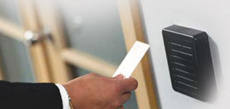
demonstration

